Slide 1
Team: I need a job Topic: movie analysis 2019 Pre-covid joy
What is the best proxy for box office earnings?
Metascore? IMDB score? Rotten Tomatoes?

Slide 2
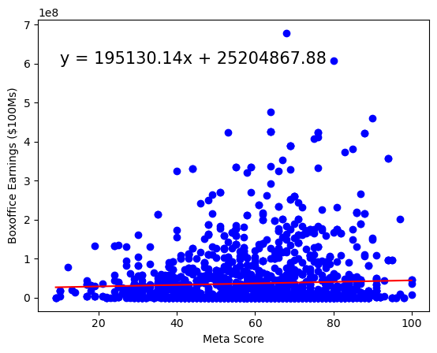
metascore
WHAT IS METASCORE?: Metacritic is a scoring system launched in 1999 that accumulates reviews of films, TV shows, music albums and video games. They use a minimum of 4 reviews from some of the world’s most respected critics to apply a weighted average that provides the ‘Metascore’ for the movie.
Scatterpoints:
Linear regression: No relationship.
Pvalue: 0.05

Slide 3
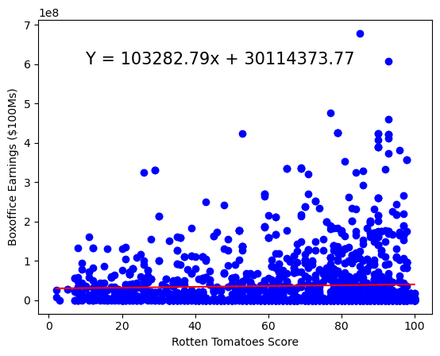
Rotten Tomatoes Score
WHAT IS Rotten Tomatoes?: Rotten tomatoes was founded in 1998 as a rating system that uses critic reviews as well as an audience score. To be in their certified fresh status they require at least 5 reviews from top critics and a minimum of 80 reviews in their audience scores for wide release films.
Scatterpoints:
Linear regression: No relationship.
Pvalue: 0.04

Slide 4
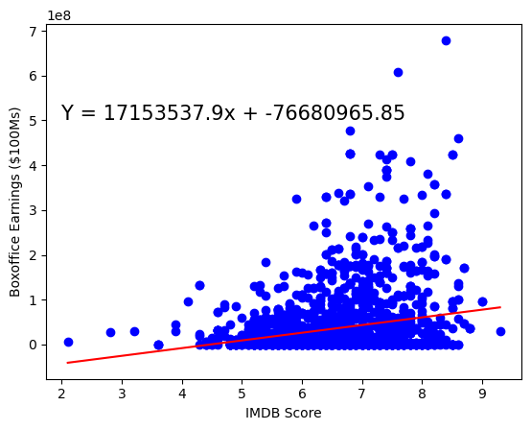
IMDB Score
WHAT IS IMDB?: IMDb was created in 1990 and uses a voter system for their ratings. Each registered user can cast one vote from 1 to 10 per title. Those votes are then aggregated into a single IMDb rating that appears on the title page of a movie on their website.
Scatterpoints:
Linear regression: No relationship.
Pvalue: 0.22

Slide 5
In conclusion: based on the pvalues of each analysis we determined x to be the most statistically significant in determining a movie’s box office success. Meta_p: IMDB_P: Rotten_p:
Notes:
Consider talking about:
Stand-alone films
Superman/Batman
Justice League (JLA)
Year One
The Dark Knight Returns
DC Animated Movie Universe
DC animated universe
Justice League: Gods and Monsters
Other universes

Slide 6
Team members:
Dakota Newcomb: Likes long bubble baths and her dream vacation is seeing the aurora borealis in Alaska.
Noah Jaramillo: Likes long walks on the beach and a cool breeze blowing through his hair.
David Niles: Loves his dogs Oliver and Bella with all his heart and his favorite pastime is flying high in the clouds.
Abby Boulter: Loves to paint forest scenery and wishes magic were real.

Slide 7
Works cited
APIs:
https://www.themoviedb.org/
https://www.omdbapi.com/
Code assistance:
https://stackoverflow.com/
https://courses.bootcampspot.com/courses/3707
https://pandas.pydata.org/
Background Info:
https://www.metacritic.com/about-metascores
https://help.imdb.com/article/imdb/track-movies-tv/ratings
https://www.rottentomatoes.com/about

